Slide 1
Hardware Implementation
Convolutional Neural Network(CNN)
Aashu Singhal
Atharva Tiwari
Mihir Agarwal
Zaqi Momin
21110002
21110038
21110128
21110132
Instructor:
Mentor:
Joycee Mekie
Tom Glint

Slide 2
PROJECT BRIEF
Aim: To build a CNN, with less layers and more filters to classify images
in the CIFAR-10 dataset.
Hardware Communication Protocol: UART
RAM: BRAM
Datasets: CIFAR-10

Slide 3
Weekly Plan
Week 1: Ideation phase: Research on Basys Board, convolution, max pooling and how to train data in python.
Week 2: Understanding UART functioning and multiplying the input data by a particular factor in UART.
Week 3: Loading CIFAR 10 Dataset and split it into train-validation-test sets with appropriate shuffling, training of neural networks and Hyper tuning.
Week 4: Implementation of Bram, verilog implementation of CNN architecture and storing it to the FPGA board.

Slide 4
ORDER OF TASKS EXECUTED
Implementation of Bi-directional UART using verilog.
Loading of CIFAR - 10 dataset and split into train-validation-test sets.
Rudimentary implementation of 3D CNN without actual weights on FPGA.
Training and hyperparameter tuning.
Integration with the complete weights to achieve complete classification.
Verilog implementation of CNN architecture and storing it in FPGA(Basys 3) board.
Interfacing using BRAM and UART.

Slide 5
Task Division
Implementing UART for multiplication - Zaqi, Aashu
Loading CIFAR-10 dataset, creating and training of neural network in python along with Hyper tuning - Mihir
Implementing BRAM - Zaqi, Aashu, Atharva
Verilog code for taking data, convolution, max pooling and giving output image- Atharva, Mihir
Debugging the above code- Zaqi , Aashu
Extracting weights, creating data loaders in python to interface with FPGA - Mihir
Final implementation on FPGA, video demo and presentation-Mihir, Zaqi, Aashu, Atharva

Slide 6
UART
A hardware communication protocol which uses asynchronous serial transmission at an adjustable speed.
It works with serial protocols that involve transmitting and receiving of serial data.
In UART the receiver uses its internal clock signal to sample the incoming data while the transmitter uses its clock signal to generate a bitstream.
Divides the bitstream in four parts-start bit, data frame, parity bit and a stop bit.

Slide 7
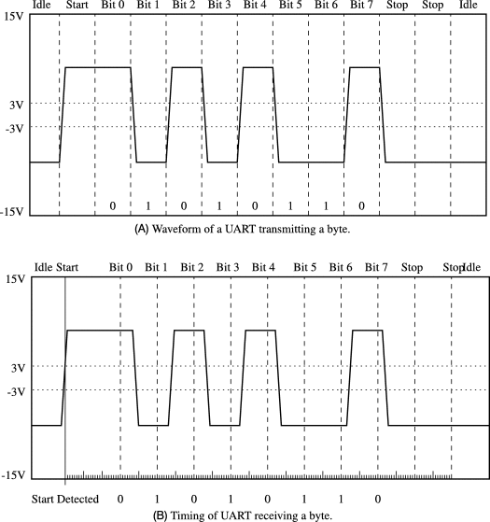
SAMPLE RESULTS
Source

Slide 8
Convolution
Two types of information can be combined using the mathematical procedure of convolution.
Convolution is used in CNN's scenario to filter the information and generate a feature map from the input data. The filter is also called kernel.
A kernel maps on the input image and performs straightforward matrix multiplication and addition on the input image, this produces output image(feature map) which is of reduced dimensions and hence easier to deal with.
The movement of kernel is always from top to bottom or left to right.
Stride specifies how far the kernel goes in steps; for instance, a stride of 1 causes the kernel to advance by one row or column at a time, while a stride of 2 advances the kernel by two rows or columns.
The detailed steps of convolution through figures are presented in the next slide.

Slide 9
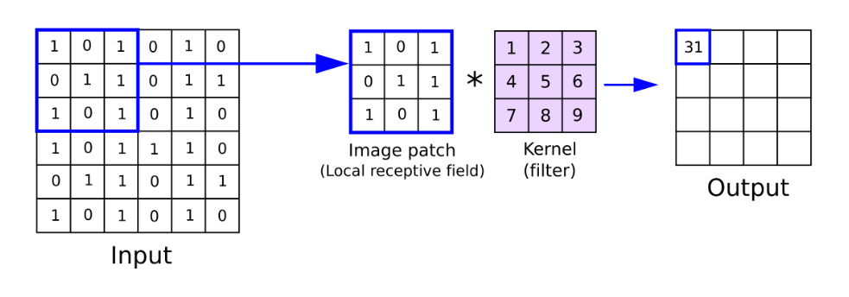
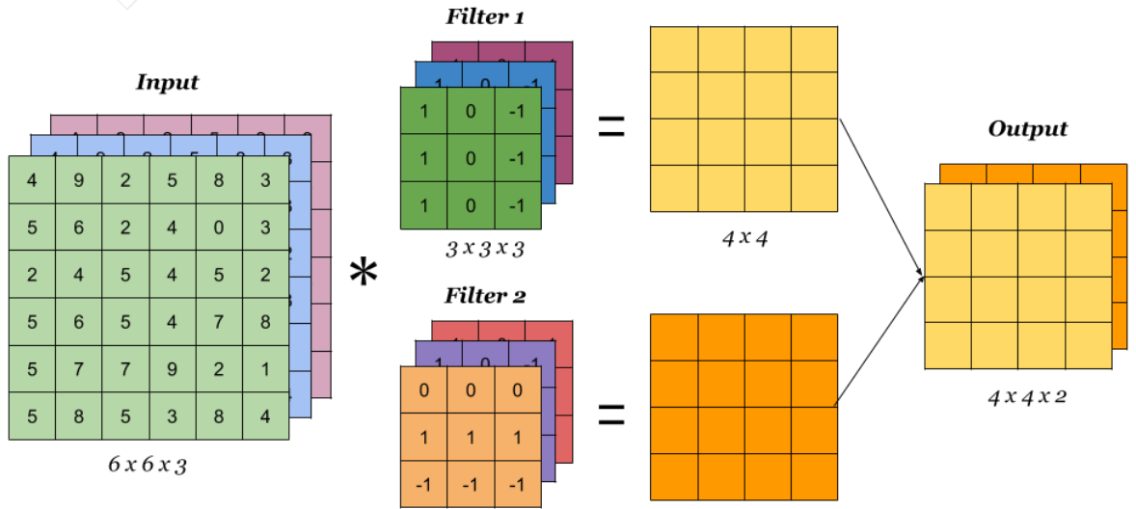
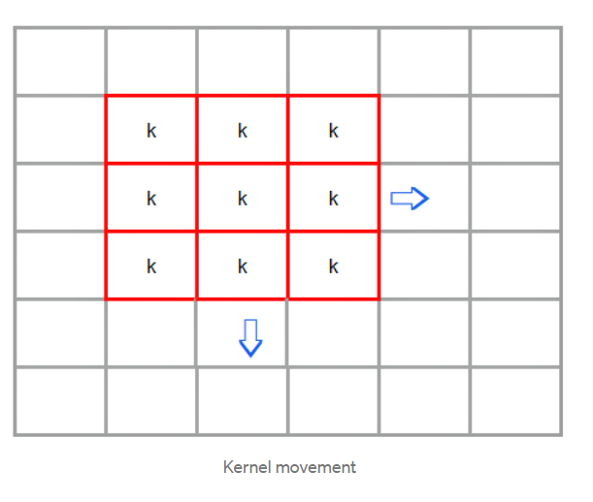
Samples
Source1
Source 2
Source 3

Slide 10
Max Pooling
A pooling layer's main goal is to "accumulate" information from maps produced by convolution of a filter with an image.
It is usually used after convolution layer.
It is accomplished by applying a max filter on initial representation initial subregions, which are typically non-overlapping.

Slide 11
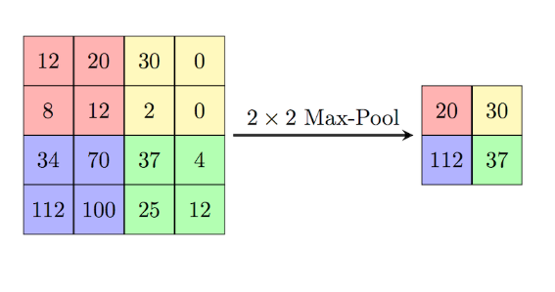
SAMPLE
Source

Slide 12
BRAM
A dual-port RAM module that was instantiated into the FPGA fabric in order to offer on-chip storage for a sizable amount of data.
Have a customizable width and depth.
It transfers the data using local FIFO (first in first out) between multiple clock signals, between an FPGA target and host processor with the help of DMA FIFO.

Slide 13
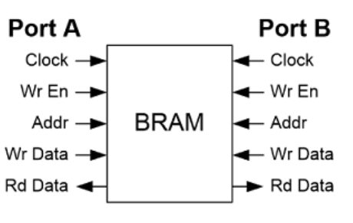
Dual Port BRAM
Source

Slide 14
CHALLENGES FACED
There was a problem in taking the input using the UART.
Convolution code was made using for loop which caused the problem of synthesis and implementation.
Convolution code using if-else statement take more than 8 hours for synthesis.
Unable to synthesis the code of max-pooling.
We are having trouble in selecting the approach to take the inputs from python.

Slide 15
FUTURE SCOPE
The accuracy of our CNN model can be improved by increasing the dataset size and the number of layers.
We can increase the speed of the convolution.

Slide 16
Acknowledgement
We would like thank the ES 203 course to give us this opportunity to work this project. We would like to thank Ms. Joycee, Mr. Tom Glint, Mr. Yashwanth, and Mr. Alok for their constant guidance and invaluable feedback.
We would also like to thank team 3, to help us debug the code and help in the ideation.

Slide 17


